Slide 1

SNS
Simple Notification Service
HackTricks Training
https://t.me/CyberFreeCourses

Slide 2
Basic Information
Amazon Simple Notification Service (Amazon SNS) is a fully managed messaging service for both application-to-application (A2A) and application-to-person (A2P) communication.
The A2A pub/sub functionality provides topics for high-throughput, push-based, many-to-many messaging between distributed systems, microservices, and event-driven serverless applications. Using Amazon SNS topics, your publisher systems can fanout messages to a large number of subscriber systems.
https://t.me/CyberFreeCourses
https://cloud.hacktricks.xyz/pentesting-cloud/aws-security/aws-services/aws-sns-enum

Slide 3
Difference with SQS
SQS is a queue-based service that allows point-to-point communication, ensuring that messages are processed by a single consumer. It offers at-least-once delivery, supports standard and FIFO queues, and allows message retention for retries and delayed processing.
On the other hand, SNS is a publish/subscribe-based service, enabling one-to-many communication by broadcasting messages to multiple subscribers simultaneously. It supports various subscription endpoints like email, SMS, Lambda functions, and HTTP/HTTPS, and provides filtering mechanisms for targeted message delivery.
While both services enable decoupling between components in distributed systems, SQS focuses on queued communication, and SNS emphasizes event-driven, fan-out communication patterns.
https://t.me/CyberFreeCourses
https://cloud.hacktricks.xyz/pentesting-cloud/aws-security/aws-services/aws-sns-enum

Slide 4
Manual Enumeration
# Get topics & subscriptions
aws sns list-topics
aws sns list-subscriptions
aws sns list-subscriptions-by-topic --topic-arn <arn>
https://t.me/CyberFreeCourses
https://cloud.hacktricks.xyz/pentesting-cloud/aws-security/aws-services/aws-sns-enum

Slide 5
Privilege Escalation
DEMO
sns:AddPermission
Grant extra permissions.
sns:Publish
Inject messages in a topic
sns:Subscribe
Get sensitive information from a message
https://t.me/CyberFreeCourses
https://cloud.hacktricks.xyz/pentesting-cloud/aws-security/aws-privilege-escalation/aws-sns-privesc
Notes:
Send and listen for a message

Slide 6
Post Exploitation
Disrupt Messages
Remain undetected by interrupting the messages alerting about you
sns:DeleteTopic
Remove the topic
sns:SetTopicAttributes, sns:SetTopicAttributes
Affecting its performance, security, or availability.
sns:Subscribe, sns:Unsubscribe
Subscribe or unsubscribe to an SNS topic
sns:RemovePermission
Remove permissions of principal
https://t.me/CyberFreeCourses
https://cloud.hacktricks.xyz/pentesting-cloud/aws-security/aws-post-exploitation/aws-sns-post-exploitation

Slide 7
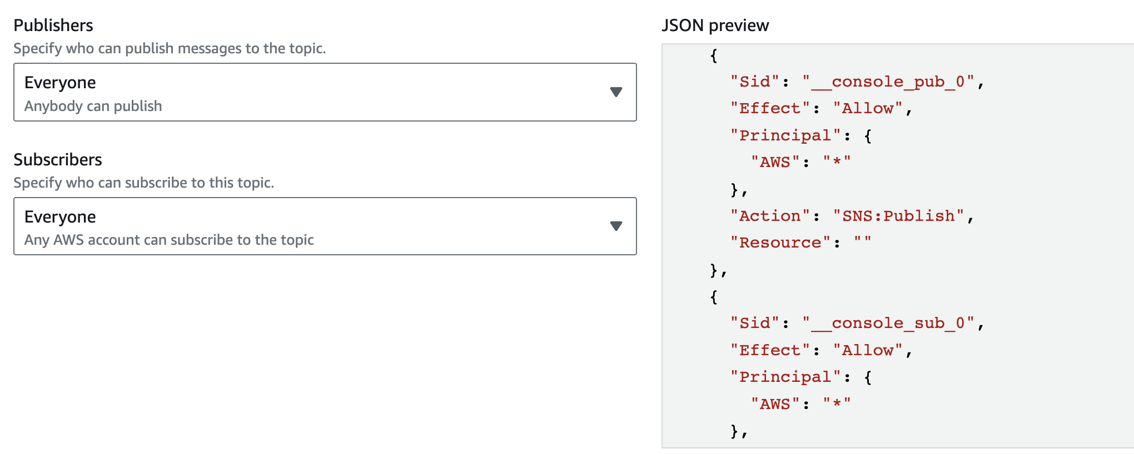
Persistence
https://t.me/CyberFreeCourses
https://cloud.hacktricks.xyz/pentesting-cloud/aws-security/aws-persistence/aws-sns-persistence

